Slide 1
AVSE (Audio-Visual Speech Enhancement)
2020.07.08
Chuang Shang-Yi

Slide 2
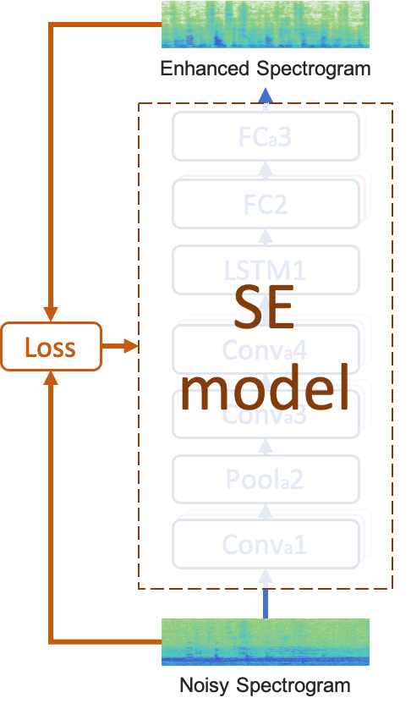
DL-based Spec-Mapping SE
Use STFT transform to process waveform
acquired: noisy spec, noisy phase
Input noisy spec to SE model
loss: spec
acquired: enhanced spec
Reconstruct waveform
by enhanced spec and noisy phase

Slide 3
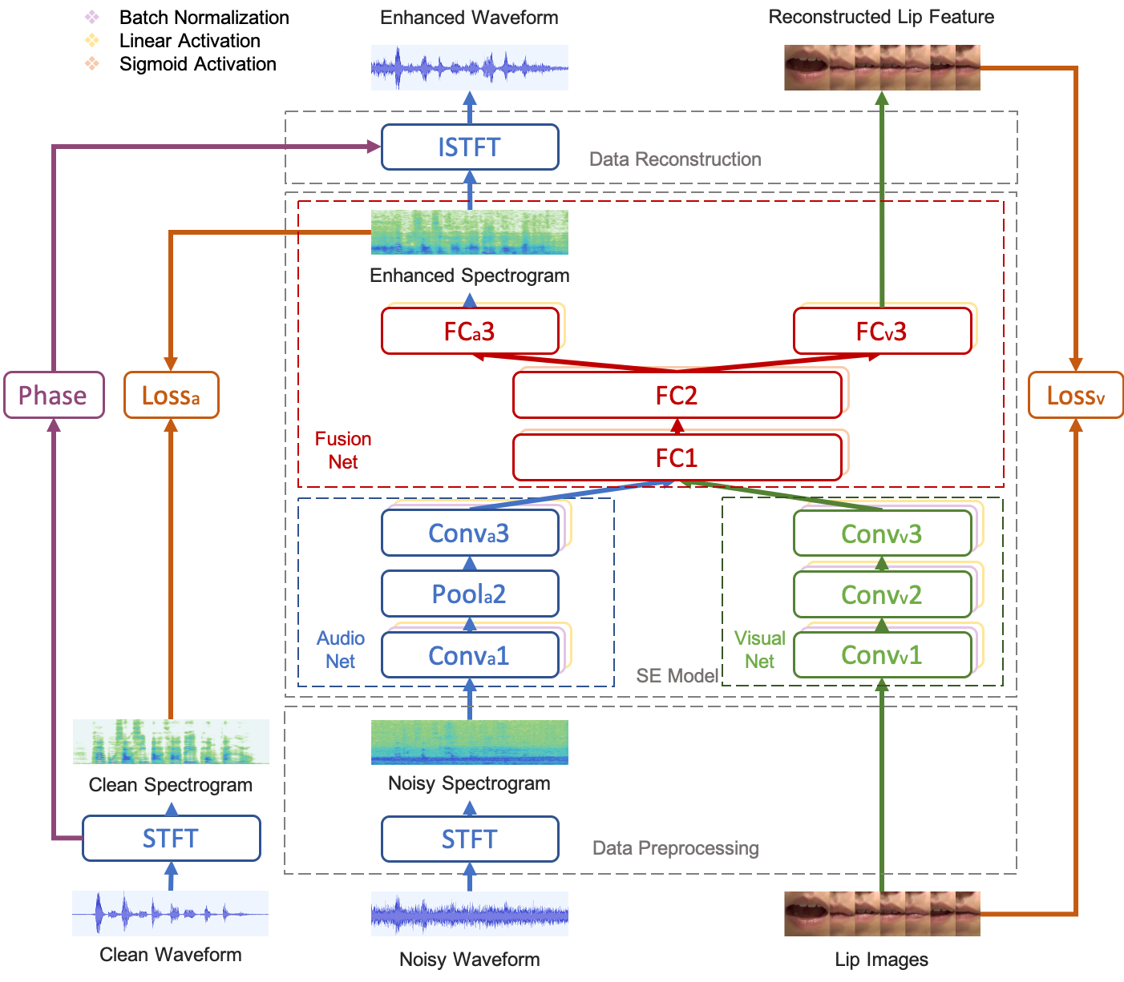
AVSE
AVDCNN (Hou et al.)
Incorporate visual information
Visual net
Multiple loss
audio loss: spec
visual loss: image

Slide 4
AVSE Problems
Additional visual processing costs
Compression
Privacy problems of facial data
Encoding
Scenario: audio assistant for car driving
Visual capture failure inside tunnels
Other problems

Slide 5
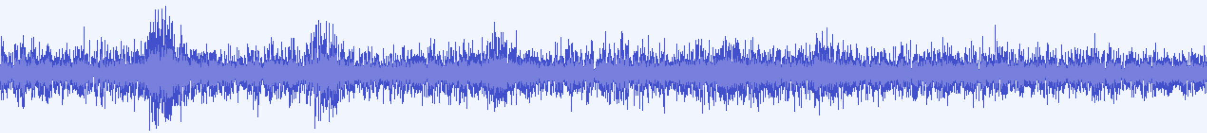
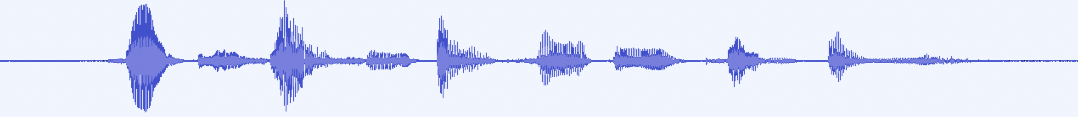
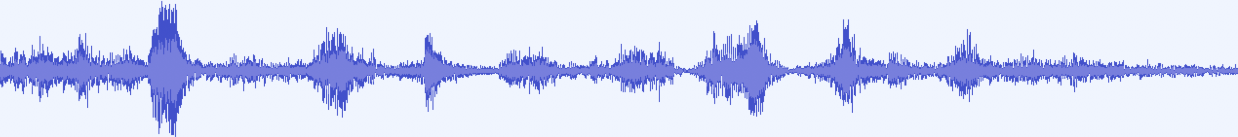
Cochlear x AVSE
SE
Cochlear
Simulation
Listening
Test
Noisy
Waveform
Enhanced
Waveform
Filtered
Waveform
Intern
AVSE Done
Code Exists

Slide 6
SP05, SP13 engine, street 0db, 5db
 | Noisy | Enhaned | Filtered
PESQ | 1.352 | 1.768
STOI | 0.737 | 0.774

